Slide 1

UTM
Universal Triage Model
Universal IT approach in industrial workflows
Team:
Abed Haj Yahia, Amit Hazan, Lior Mizrachi

Slide 2

Introduction
The process of triage in IT can be long and expensive Whether it is in the lengthy tickets, vague descriptions or complex systems.
For that purpose, we have trained a model that helps discern the root of the problem in the system and the severity of said problem.
Our model can take in support ticket text and quickly detect the root of the issue and how problematic it is.

Slide 3

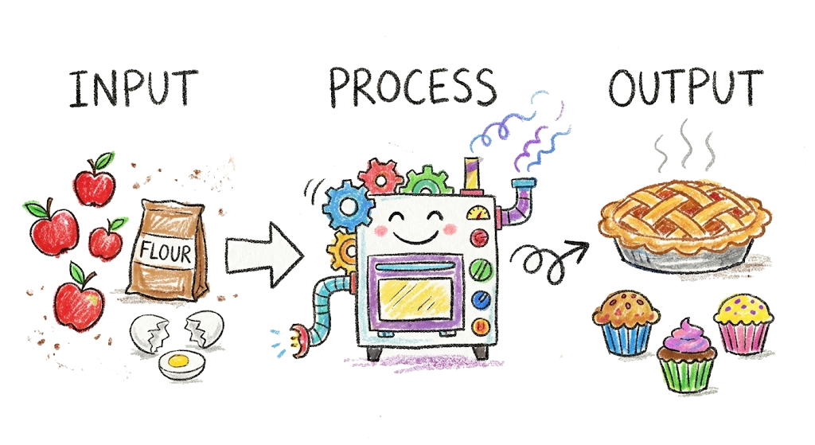
TECHNICAL APPROACH
Model Architecture
Model Pipeline
GPT-3.5 for data generation, Llama 3.2 baseline, RoBERTa fine-tuning
Input Processing
Company background (industry, enterprise information system)
Workflow description
Components
User report ticket
Output
Affected component
Severity level (Medium, High, Critical)
Component Metrics
Severity Metrics
Accuracy, Top-k ranking
F1 Score (macro), Accuracy, Weighted F1

Slide 4
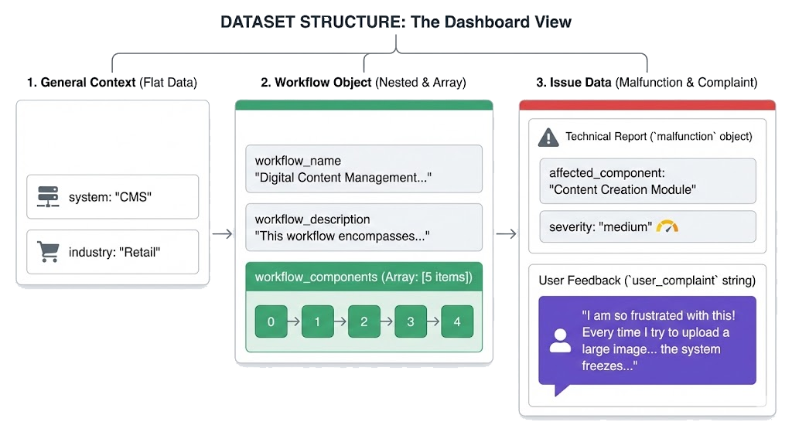

Slide 5


PROJECT OVERVIEW
Problem & Solution
Current Challenge
Our Innovation
Manual ticket classification is costly and time-consuming
Universal AI model adaptable across varied software systems
High operational costs
Automated classification
Slow response times
Multi-company deployment

Slide 6
TECHNICAL APPROACH
Model Development & Data Strategy
Data Generation
Baseline Models
~2220 training examples, ~400 test examples
Llama 3.2 for zero-shot and few-shot testing
Fine-Tuned Models
Refinement Efforts
Component Classification
Increase data diversity & quantity
Binary relevance classifier & ranking model
Adjust metrics (eval loss for best model)
Metrics: F1, Accuracy, Recall, Precision
Component classification formulated as a ranking problem
Severity Classification
RoBERTa-base for Critical/High/Medium
Metrics: F1 (macro & weighted), Accuracy, Recall, Precision

Slide 7








Category | Component Model | Severity Model
Main Task | Binary Classification (Ranker Approach) | Multi-class Classification (3 severity levels)
Data Preparation | Explosion: Splitting each issue into separate rows for every component | Contextual Prompt: Including Industry, System, and User Experience
Number of Epochs | 3 | 10 (with Early Stopping)
Learning Rate (LR) | 3e-5 | 1e-5
Layer Freezing | None (Full training) | Freezing the first 4 layers
Imbalance Management | WeightedTrainer (weights for Label 1) | WeightedTrainer (weights for Critical and High)
Primary Metrics | Top-2 Accuracy and F1 | Macro-F1 and Accuracy
Regularization | Early Stopping, Weight Decay | Early Stopping, Weight Decay, Layer Freezing, Warmup

Slide 8
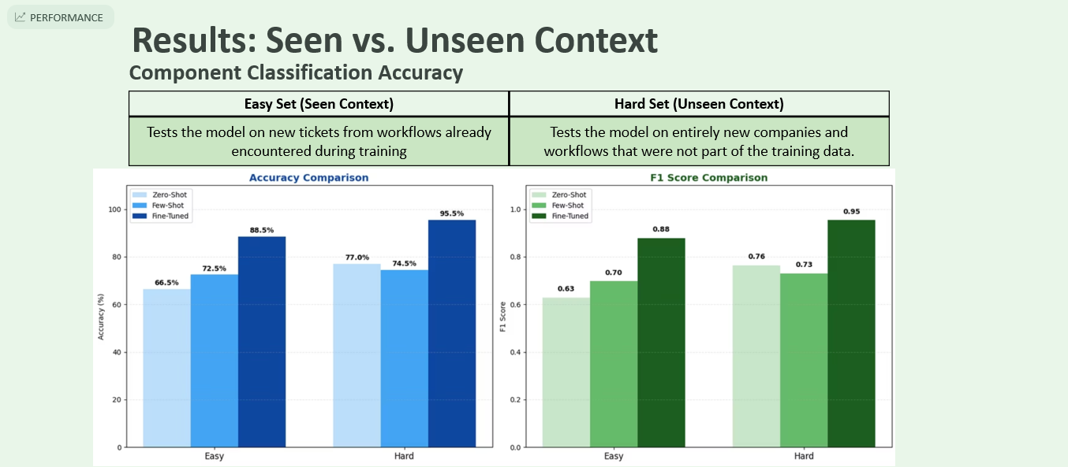
Dataset
Zero-Shot
Few-Shot
Fine-Tuned
Gain
Easy
66.5%
72.5%
88.5%
+16.0%
Hard
76%
73%
95.5%
+19.5%

Slide 9
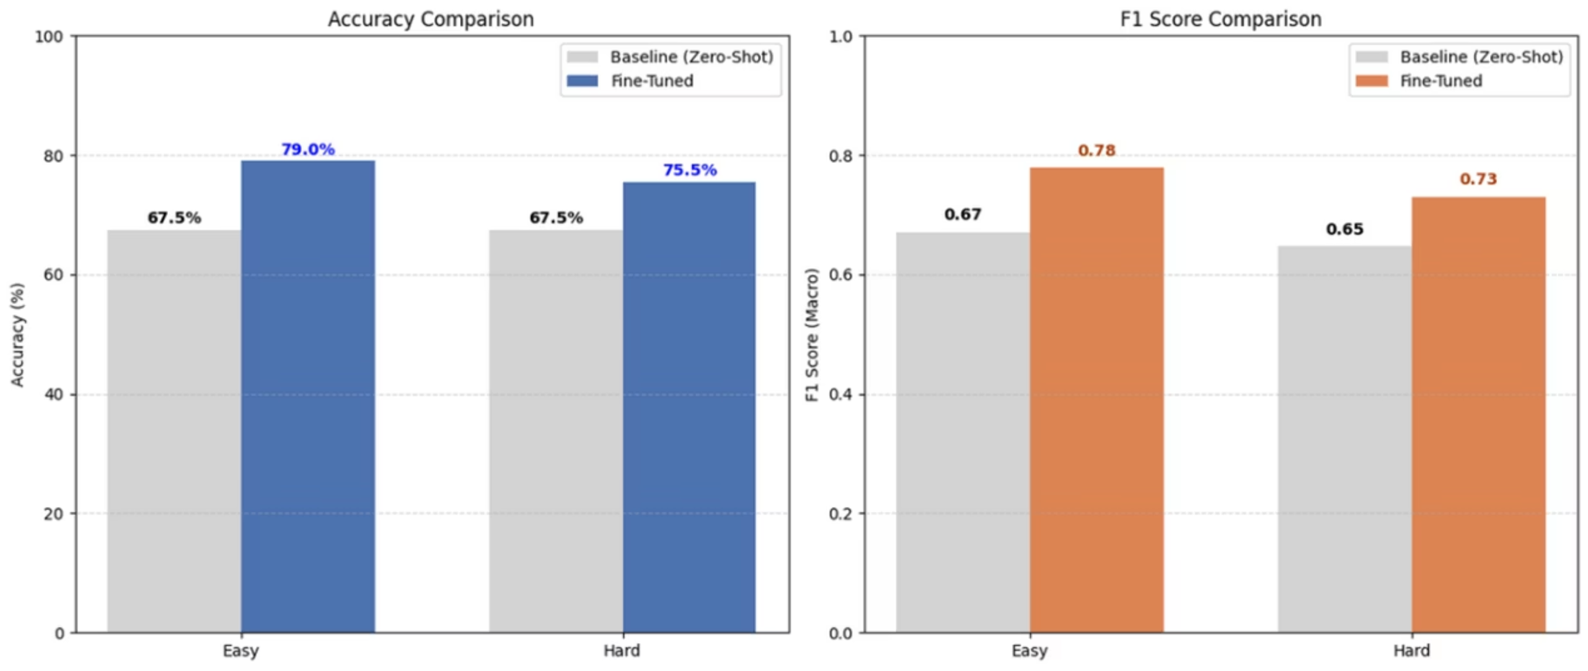
Severity Classification Performance
Dataset
Baseline Acc
Fine-Tuned Acc
Baseline F1
Fine-Tuned F1
Easy
67.5%
79%
0.6708
0.7783
Hard
67.5%
75.5%
0.6475
0.7303

Slide 10



INSIGHTS
Key Learnings & Future Directions
Achievement
Successfully trained universal model that predicts components and severity on unseen workflows
Critical Lessons
Clear label definitions essential
Testing on unseen data is crucial
Future Exploration
Real-World Data
Learning from feedback
Deploy with multiple companies, collect real tickets for enhanced training
User corrections as supervision signals for continuous model improvement

